Slide 1
Team : CAFÉ_IN
Café recommendation
by keyword
김우석 김정문 임민우 허환욱

Slide 2
Contents
01. Purpose
02. Data crawling
03. Preprocessing
04. TF-IDF and Word2vec
05. App demonstration video
06. Improvements

Slide 3
01 . Purpose

Slide 4
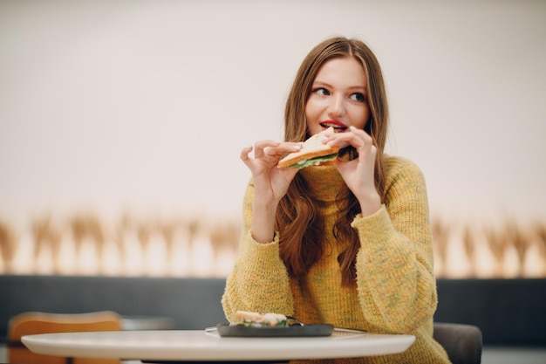
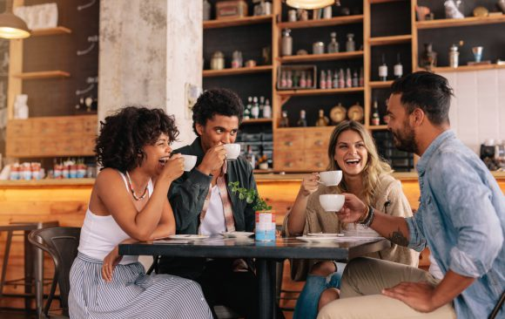
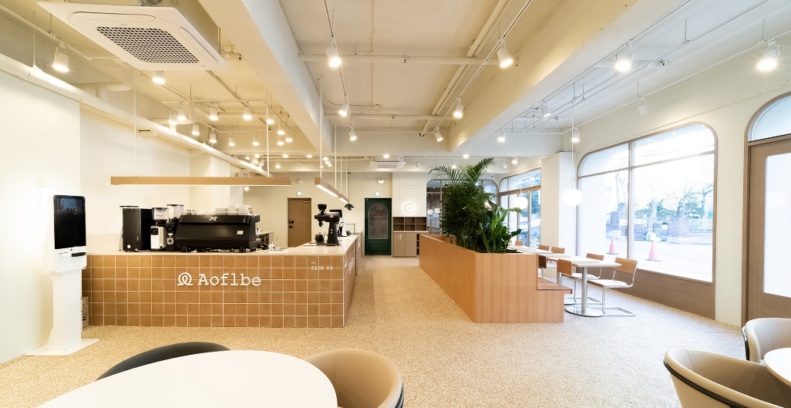

01. Purpose
Sandwich , Bread
Coffee
Space,
mood
Good~

Slide 5


01. Purpose
Other cafes…? Other regions…?

Slide 6
02 . Data crawling

Slide 7
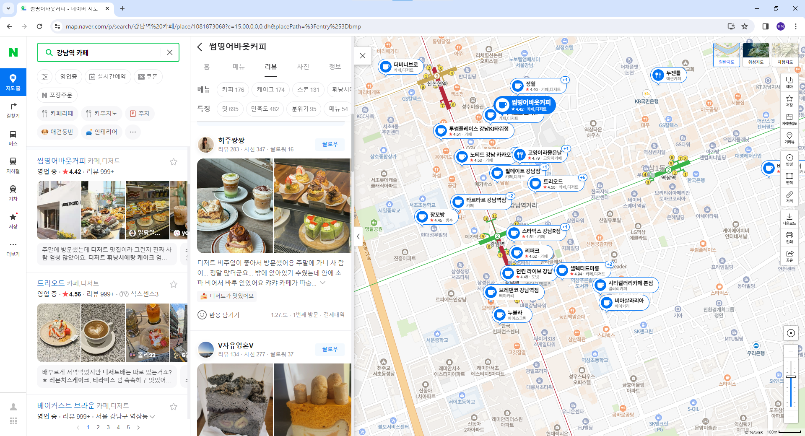
02. Data crawling
Naver map

Slide 8
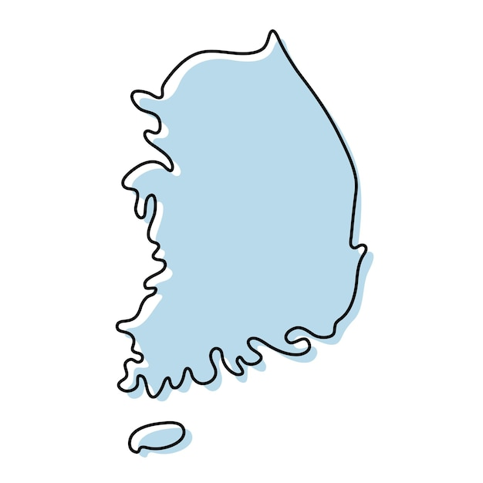

02. Data crawling
Seoul
Gangnam,
Itaewon…etc
Daegu
Myeongdeok ,
Jungang-ro…etc
Suwon
Ingye-dong,
Haenggung-dong…etc
Busan
Seomyeon,
Haeundae…etc
Daejeon
Dunsan-dong,
Daeheung-dong…etc
40 regions, 4000 cafes, Total 400k reviews

Slide 9
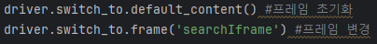
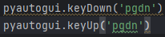
02. Data crawling – Difficulties and solutions
Frame issue
Scroll issue
search
Iframe
entry
Iframe

Slide 10
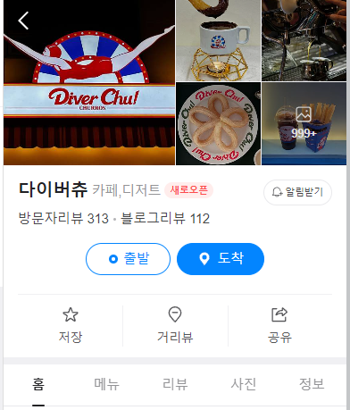
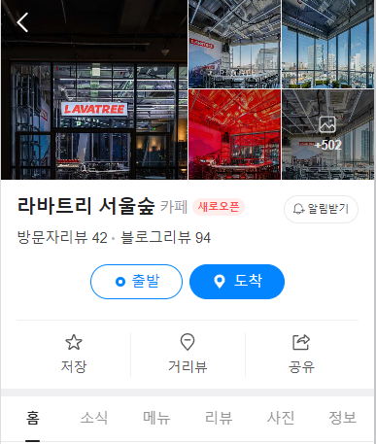
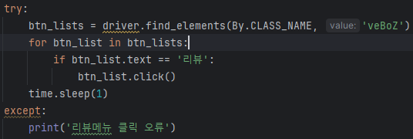
02. Data crawling – Difficulties and solutions
Review menu button location issue
//*[@id="app-root"]/div/div/div/div[4]/div/div/div/div/a[2]
//*[@id="app-root"]/div/div/div/div[4]/div/div/div/div/a[3]

Slide 11
03 . Preprocessing

Slide 12
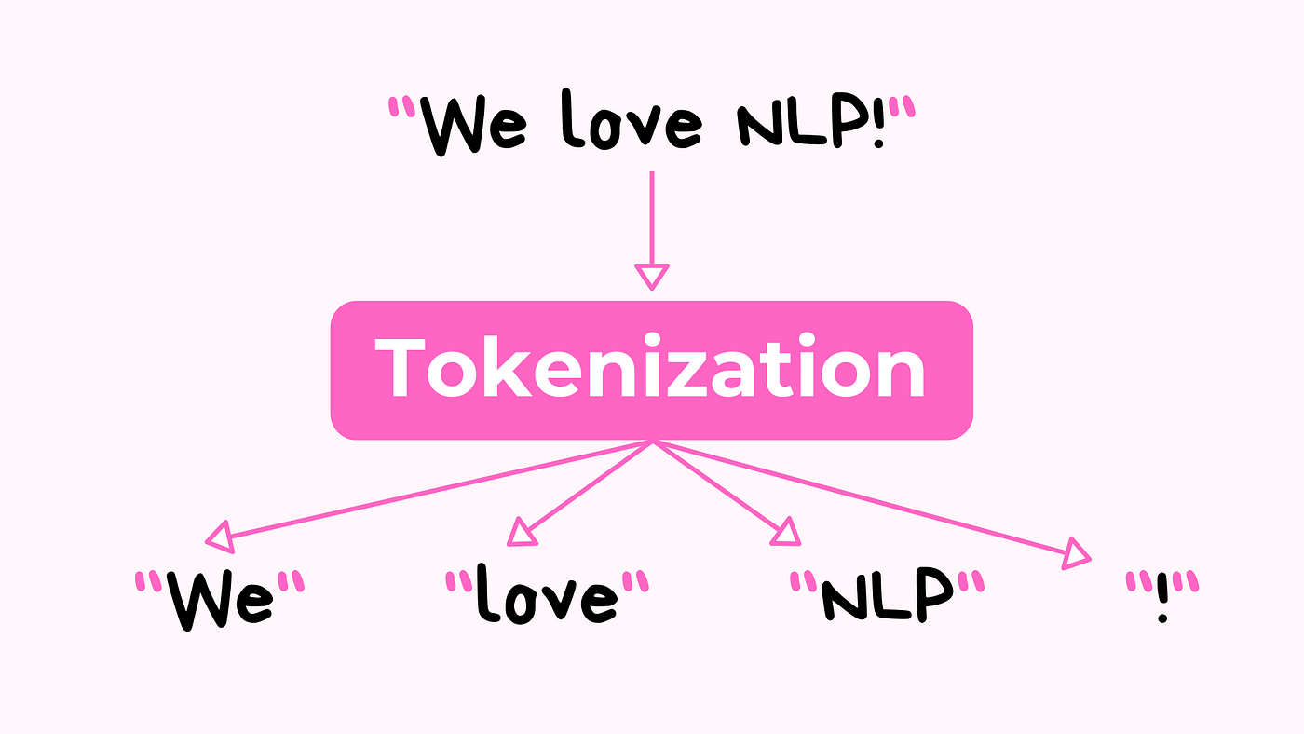
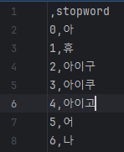
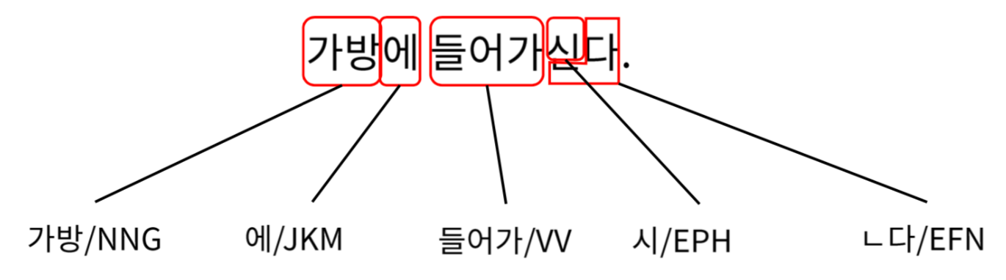
03. Preprocessing
Morpheme seperation
Remove stop words

Slide 13
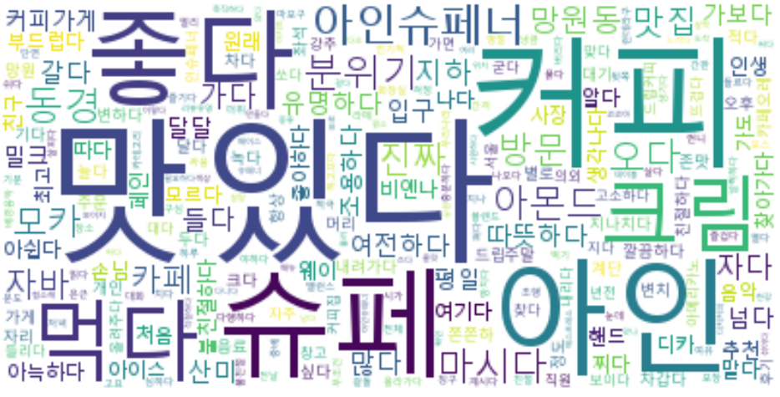
03. Preprocessing
Remove stop words
Unnecessary words appearing in Word cloud
Combining morphemes
And
Tokenization

Slide 14
04 . TF-IDF and Word2vec

Slide 15
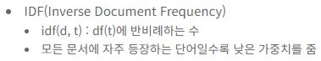
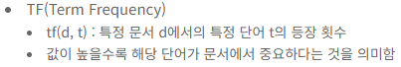
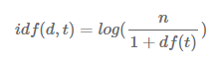
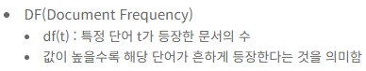
04. TF-IDF and Word2vec – TF-IDF
TF-IDF?

Slide 16
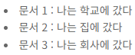
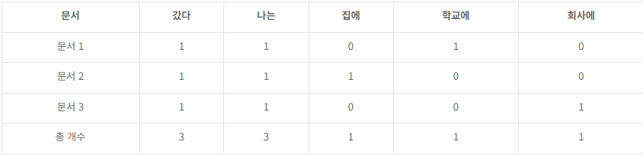
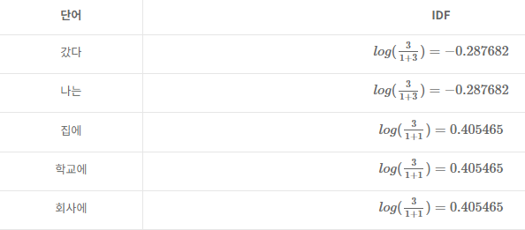
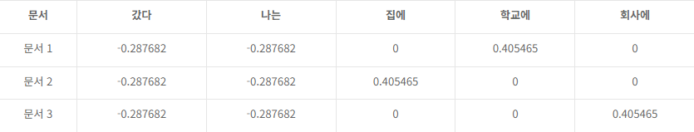
04. TF-IDF and Word2vec – TF-IDF
TF-IDF Example
TF
IDF
TF-IDF(TF x IDF)

Slide 17
04. TF-IDF and Word2vec – TF-IDF
TF-IDF matrix

Slide 18
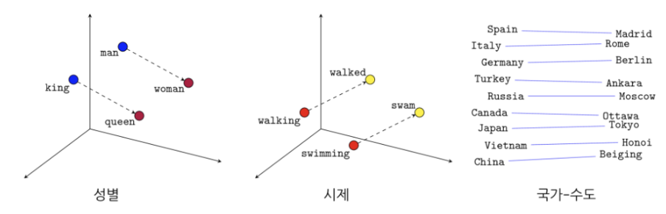
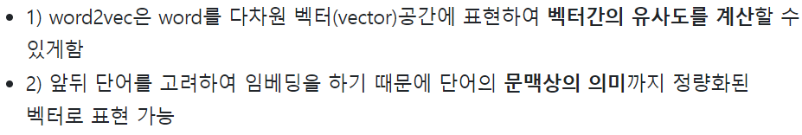
04. TF-IDF and Word2vec – Word2vec

Slide 19
05 . App demonstration video

Slide 20
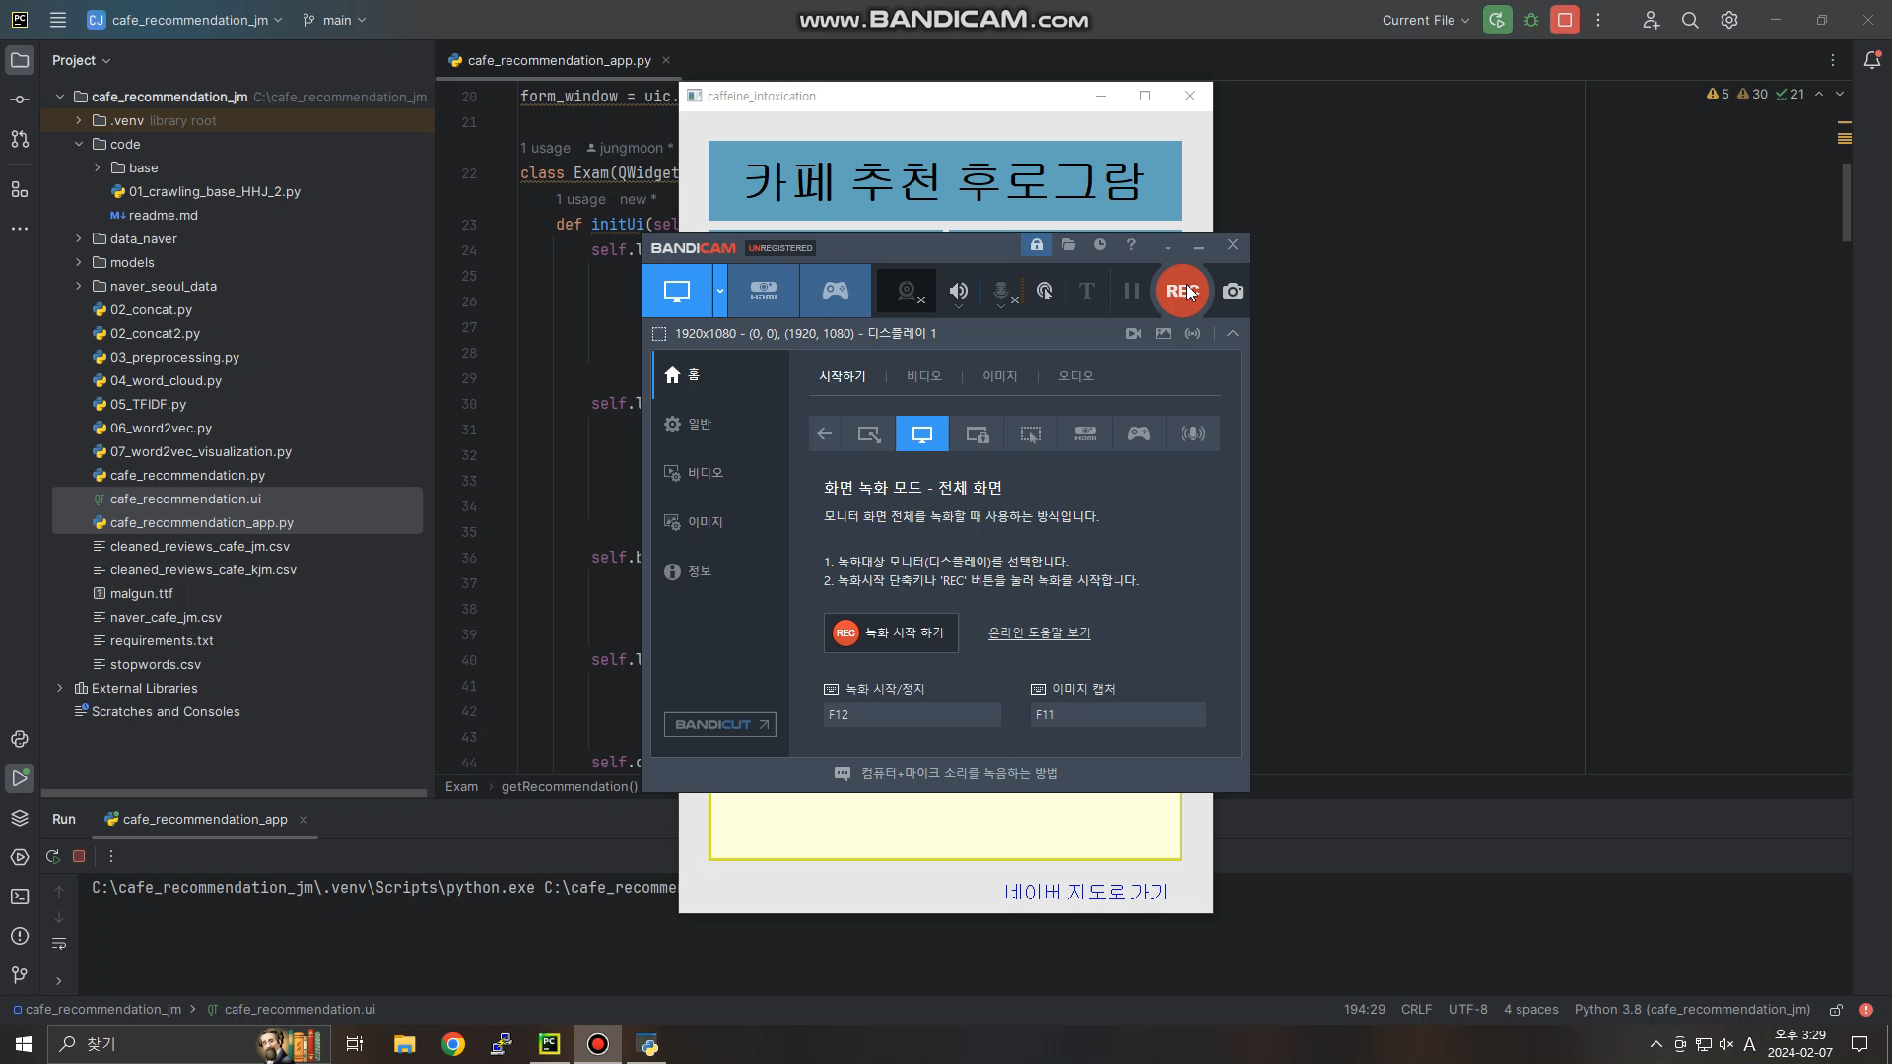
05. App demonstration video

Slide 21
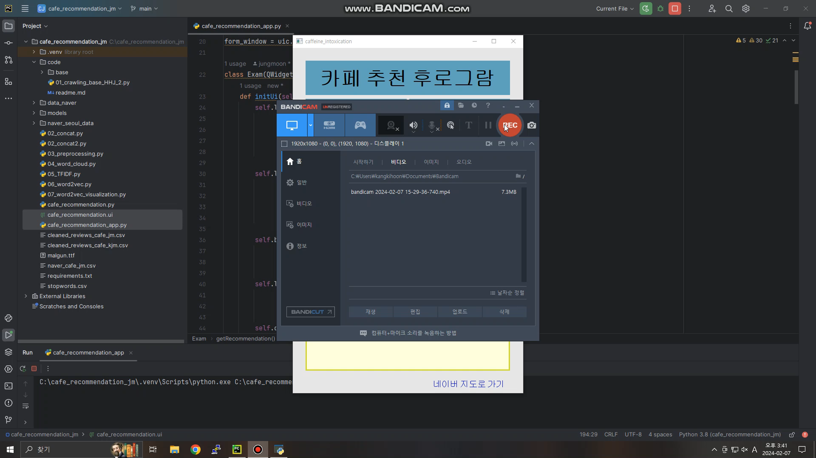
05. App demonstration video

Slide 22
06 . Improvements

Slide 23
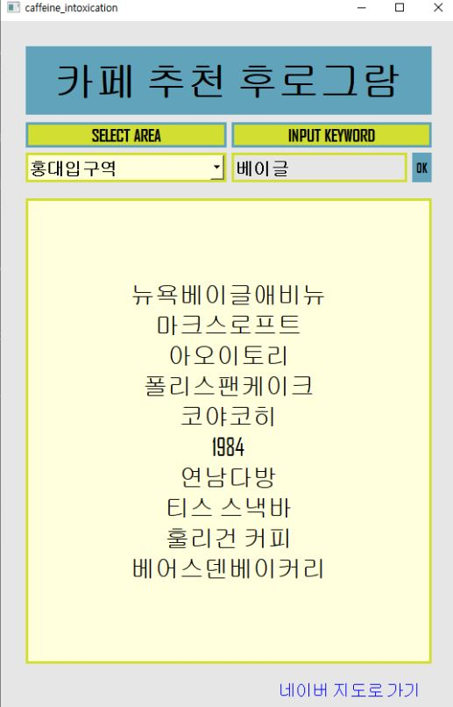
06. Improvements
Display café summary information
Add café link

Slide 24
Thanks !

Slide 25
Q & A

